Slide 1
Non SSO
Profile Required
Process Flow and Steps

Slide 2
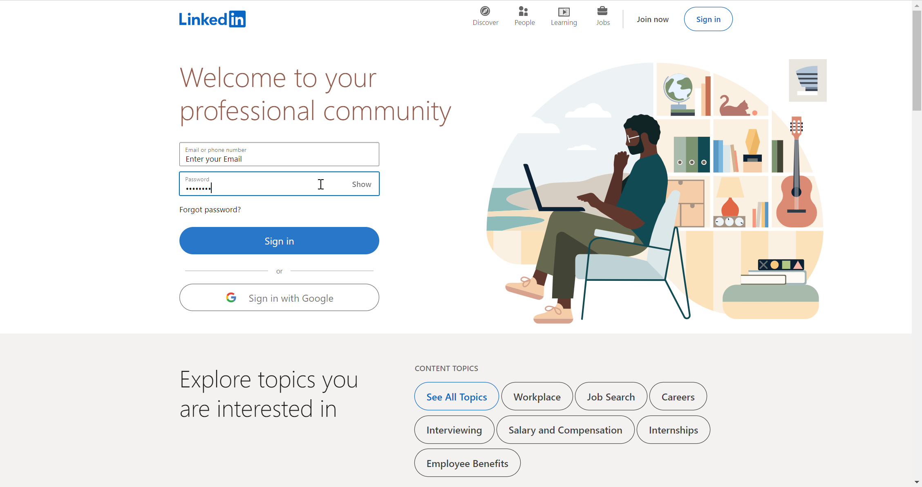

Compulsory Requirement - LinkedIn .com Profile Page
1
If you are creating a LinkedIn profile for the first time , please select “Join Now” and create your profile on LinkedIn.com
If you are an existing LinkedIn user, then please Login to your LinkedIn Page.
In case you forget password, please reset the password to a new one. You can click on “Forget Password?“ button
To Create new LinkedIn.com profile, goto https://www.linkedin.com/home

Slide 3
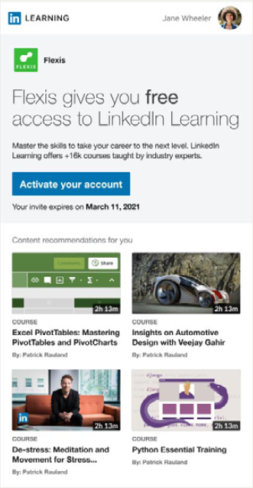
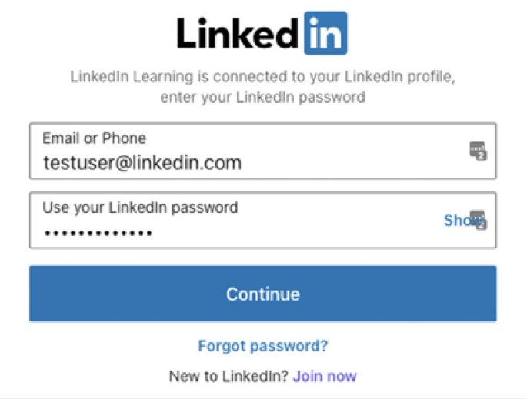

3
4
2
Once Admin assigns license, the activation link will goto learner’s Institute’s email id
Click on the activation link to be prompted to connect or create LinkedIn profile
5
Please use the email and password you used when registering on LinkedIn.com profile,
Pro Tip: Please don’t create another LinkedIn.com profile with your institute’s email id if you already have an existing profile. In case you have forgotten password, try to recover the password

Slide 4
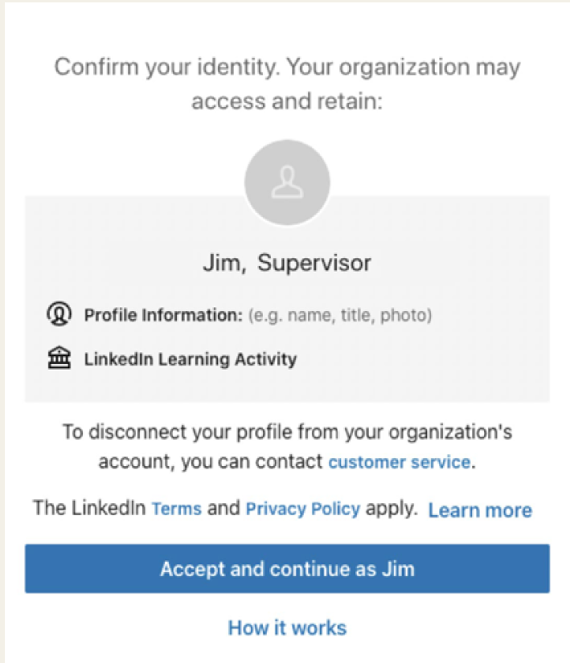

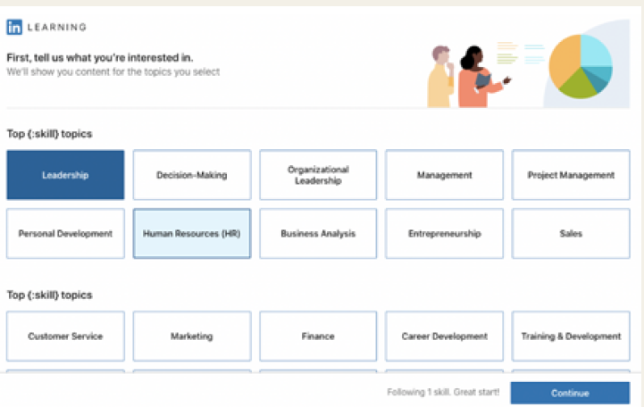
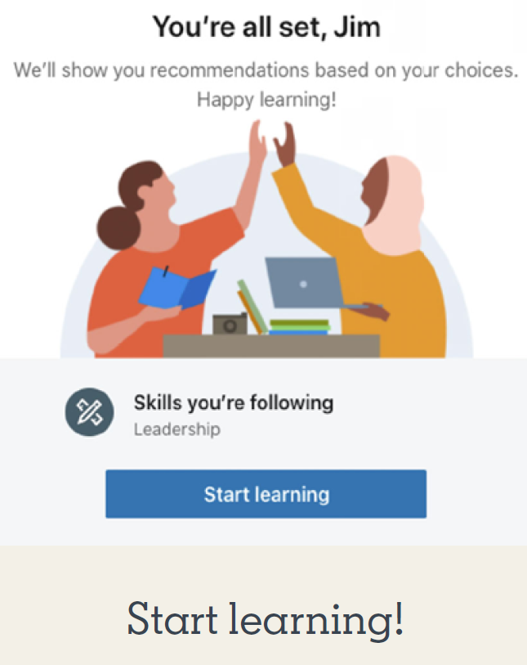
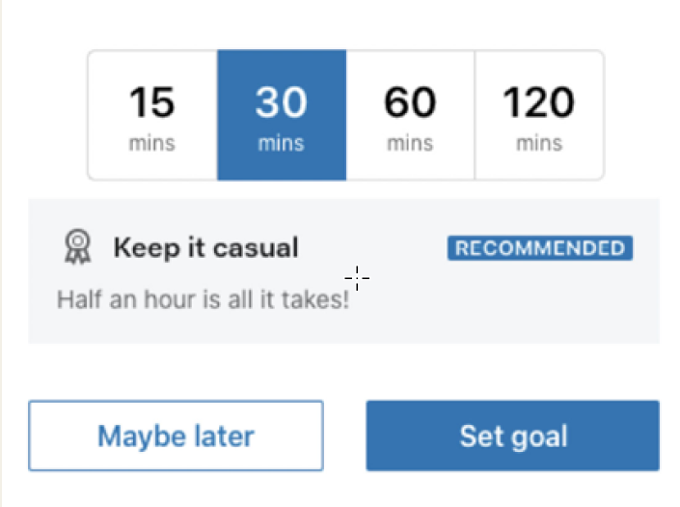
6
Welcome to LinkedIn Learning Page !
Next, you will see a screen asking you to confirm your identity. Click accept and continue.

Slide 5

Process - First Time Login to LinkedIn Learning
START
2
Admin to assign Learning License
1
Create LinkedIn.com Profile with a username and password and remember the password.
4
Do you have an existing LinkedIn Profile ?
NO
You’ll be prompted to
connect or create a LinkedIn
account.
3
Click on the Activation Link will be sent to your institute’s email
5
YES
If you already have an account, please use the email and password you used when registering, which may be your personal email address.
1
Do you remember the password for your existing LinkedIn.com profile?
NO
Reset your password, which may be archived through your personal email address
6
Next, you will see a screen asking you to confirm your identity. Click accept and
continue.
YES
STOP
It will take you to LinkedIn Learning’s landing page

